Slide 1
ARTICLE OF THE MONTH
Notes:
Image: 'Beads for peace' ("Perlen für den Frieden") was the motto of Emilia, Svea and Yolanda. Over a longer period of time, the three girls made beaded jewelry together and individually at home. On March 18, 2022, the girls gave away their self-made beaded jewelry and sorted-out toys at the marketplace in Warendorf in exchange for a donation to UNICEF. Later, their younger siblings joined them and supported them in their action.

Slide 2
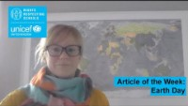
INTRODUCING EARTH DAY
Earth Day
Kathy Allan, Senior RRSA Professional Adviser, introduces Earth Day
Earth Day takes place every year on April 22 to show support for the protection of the environment and our planet.
Since 1970, Earth Day has brought together people, governments and companies from around the world, supporting them to do something positive for the environment.
It promotes the fact that ‘change starts with action’ and we can all take action and encourage others to take action that positively impacts on the world around us.
Click here to watch on YouTube

Slide 3

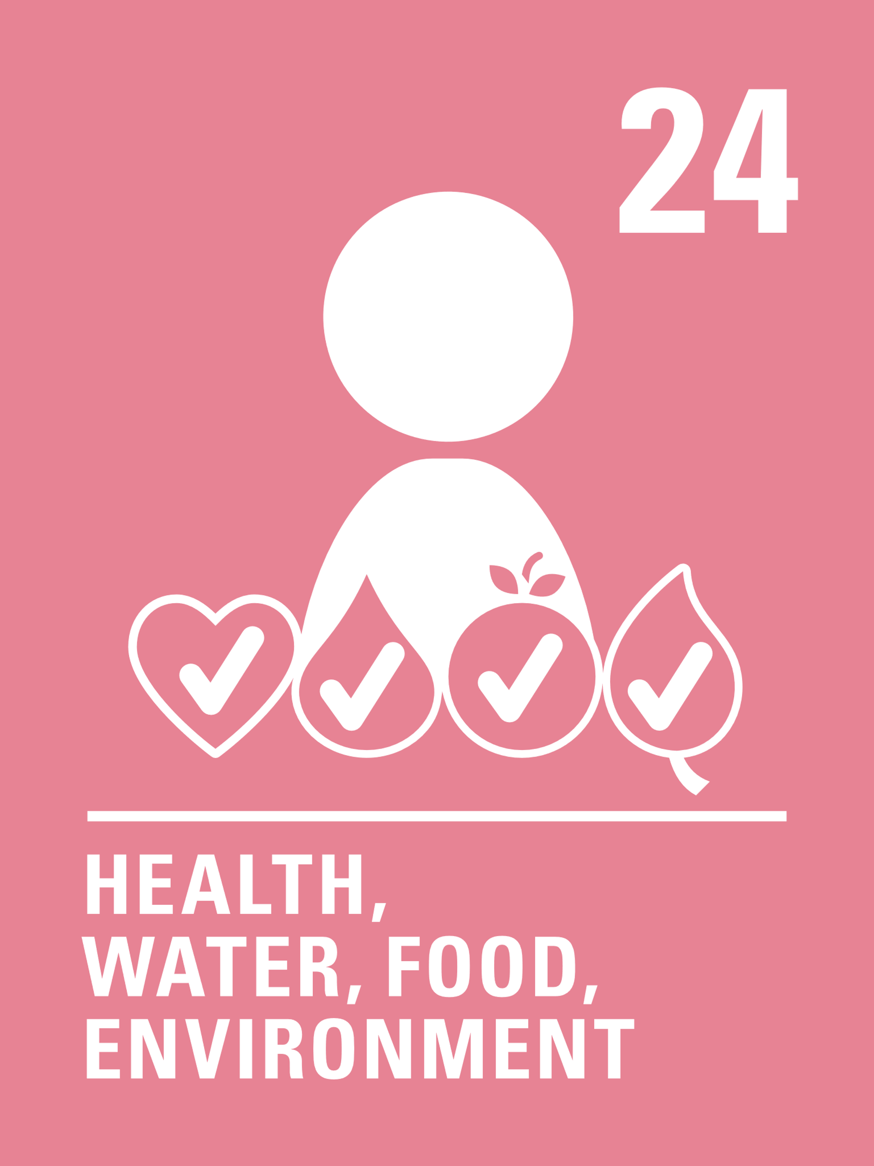
LINKED UNCRC ARTICLES
Many articles of the CRC relate to this month’s theme but the activities link, in particular, to the following articles:
Article 6 (life survival and development)
Every child has the right to life. Governments must do all they can to ensure that children survive and develop to their full potential.
Article 24 (health and health services)
Every child has the right to the best possible health. Governments must provide good quality health care, clean water, nutritious food, and a clean environment and education on health and well-being so that children can stay healthy. Richer countries must help poorer countries achieve this.

Slide 4
EXPLORING EARTH DAY
What do you, your school and your family do that helps the environment and the planet?
Have a think and write down some answers.

Slide 5
REFLECTION
Take a few minutes and find some space to be quiet and to think... If you can, go outside, look out of a window or put some images of earth and the environment on a screen…
Why is our planet special to you? What do you value most about the environment?
How can upholding everyone’s rights help protect the planet?
How will you celebrate Earth Day this year?
How can you encourage positive environmental action with friends, neighbours and family members?

